Slide 1
FanNeuro
A neuromarketing based webapp
- Shivansh & Vidipta
-Mentored by Gouri Parvathi mam

Slide 2
Contents
Neuromarketing? Can it boost the product quality?
01 | Neuromarketing
02 | The FanNeuro
03 | The progress and futhur plans

Slide 3
Introduction to Neuromarketing
Neuromarketing is a field that applies neuroscientific methods to analyze and understand human behavior in relation to markets and marketing exchanges.
Purpose: To uncover the subconscious responses and decision-making processes of consumers

Slide 4
Core Principles of Neuromarketing
Consumer Behaviour
Cognitive Processes
Understanding how consumers make decisions and what influences their preferences.
3
Studying attention, memory, and perception in the context of marketing stimuli.
1
Emotional Responses
2
Measuring emotional reactions to products, advertisements, and brands.

Slide 5
Neuromarketing Applications
1
2
3
4
Advertising
Product Design
Branding
Customer Experience
Creating more effective and engaging advertisements.
Developing products that better meet consumer needs and preferences.
Building stronger emotional connections with brands.
Enhancing the overall shopping experience to increase satisfaction and loyalty.

Slide 6
Advanced techniques in Neuroimaging and Neuromarketing
1
EEG
An EEG reads brain-cell activity using sensors placed on the subject’s scalp; it can track changes in activity over fractions of a second, but it does a poor job of pinpointing exactly where the activity occurs or measuring it in deep, subcortical regions of the brain (where a lot of interesting activity takes place).
2
fMRI
fMRI uses strong magnetic fields to track changes in blood flow across the brain and is administered while a person lies inside a machine that takes continuous measurements over time.

Slide 7
Advanced techniques in Neuroimaging and Neuromarketing
3
Eye Tracking - Gaze
Detects exactly where subjects direct their gaze.
It informs us what grabs their attention, what confuses them, and their speed of recognition.
Pros – Inexpensive; works best when used along with biometrics.
Cons – Does not measure emotions.
Can determine elements on the ads that drive more attention. This way, the marketers can know the things that stand out and hook the audience.
4
Eye Tracking - Pupillometry
Measures whether subjects’ pupils are dilated.
It reveals customers’ level of engagement.
Same pros and cons as above.

Slide 8
Advanced techniques in Neuroimaging and Neuromarketing
5
Biometrics
Measures skin conductance, heart rate, and respiration.
It informs us whether their response is positive, negative or neutral.
Pros – Works best when used along with biometrics.
6
Facial Coding
Identifies facial expressions.
Help ensure that an ad actually triggers the response it was designed to elicit.
Helps recognize general emotional response: happiness, surprise, fear, and so on.

Slide 9
How HRV can be useful?
Ads are usually less than 5 minutes long, so we need to monitor HRV for less than 5 minutes, i.e., the ‘ultra-short-term’.
PPG uses a light source and a photodetector at the skin’s surface. PPG sensor is located on the back of the smart-device so that it can contact the skin.
HRV can be monitored using wearable devices.
The ECG function on smartwatches such as the Apple Watch and Samsung Galaxy can be helpful in HRV analysis.

Slide 10
Pre-existing websites based on Neuromarketing
Affectiva
The technology primarily focuses on facial expressions, which might not capture the full range of emotional and cognitive responses compared to more comprehensive neuromarketing methods.
iMotions
High complexity and cost may require substantial training and investment.
Nielson NeuroFocus
Some advanced features and detailed reports are gated behind premium services.

Slide 11
The FanNeuro
The producer can know if certain products impact the consumer positively or otherwise, store that information, and then only present products according to a particular consumer’s taste.
The existence of such an app will help analyzers understand fan sentiments towards a product without having to ask them.
The marketing business will utilize it productively.
The consumer-satisfaction rate will reach an all-time high.

Slide 12
FanNeuro – overcoming the existing limitations
Gamifications
The UI/UX
Sponsorship
For example - daily challenges for customers, rewards after completion of challenges, leaderboards showcasing the ranks of fans of a particular product, leaderboards showcasing the most popular products on a weekly basis, comparison of an individual’s responses to average statistics, etc.
Improvements
In UI/UX makes customers more comfortable and confident towards the product.
Hiring well-known sponsors and promoters to increase the reach of the app.

Slide 13
FanNeuro – Key Features
Customization
Chat
Trending Section
An option to customize your own products through the app
And a chance for the customized product to be released as a special edition
Individual and group chatting options to help consumers with similar taste interact with each other
Saturn is composed Be able to predict how trendy a particular product will be in the near future.
A ‘trending’ section that showcases the current popularity of a particular product in a country, state, or city.
hydrogen and helium

Slide 14
How would FanNeuro help the marketing community?
The marketers will be able to analyse what kinds of products are popular among which demographic and psychographic and in which geographic areas.
1
2
They will be able to segment, target and position their products and the customers based on that data.
3
They will be able to improve ad designs, content, product-pricing, etc. with the help of customers’ neural data.

Slide 15
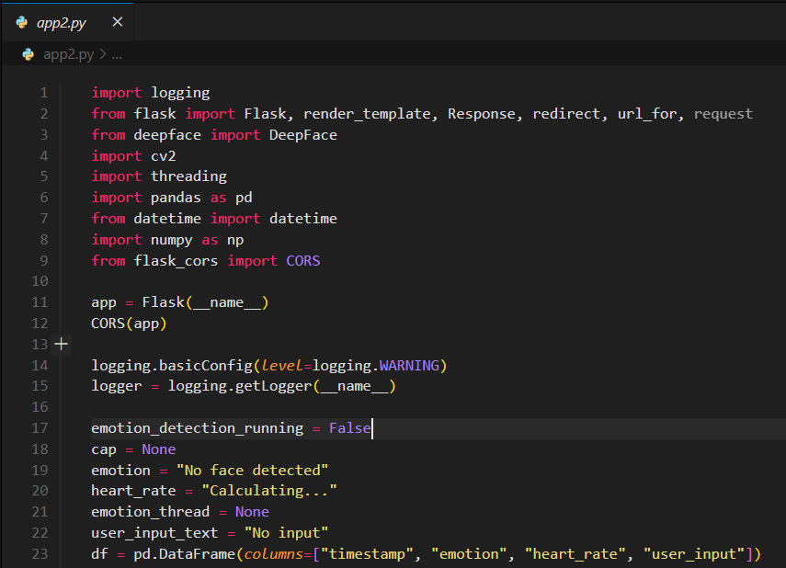
1. emotion detection utility
Python based Flask backend
Import of standard libraries –
Flask for backend server
DeepFace for emotion detection
OpenCV for capturing video input
Pandas for data handling
Datetime for time stamps
NumPy for numerical operations
Flask_cors to handle CORS issues which occurs while integrating frontend with backend as both of them are running on different endpoints

Slide 16
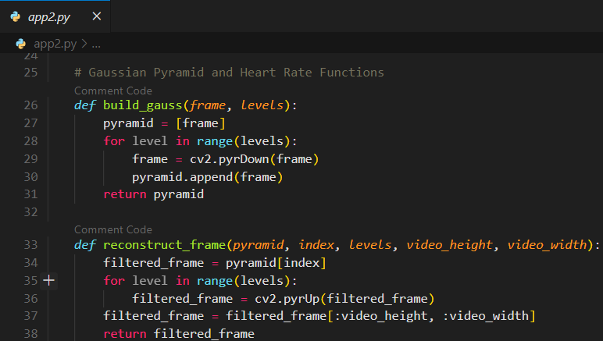
1. emotion detection utility
Python based Flask backend
Build_gauss creates Gaussian pyramid from input data frame by iteratively down streaming the frame and is used for multi-scale image processing.
Reconstruct_frame reconstructs a frame from its gaussian pyramid by iteratively up sampling it and cropping it to original dimensions.
This is used for heart rate estimation from video.

Slide 17
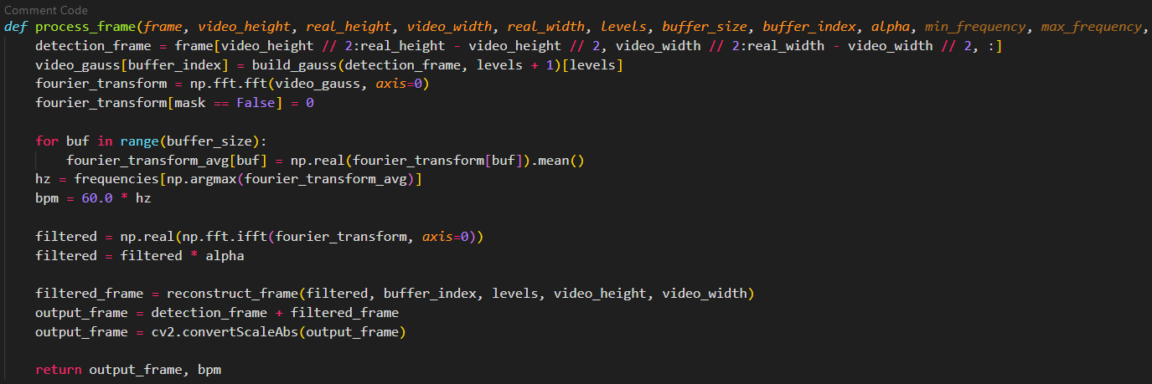
1. emotion detection utility
Process_frame detects subtle changes in video corresponding to heartbeats for heart rate monitoring
Python based Flask backend

Slide 18
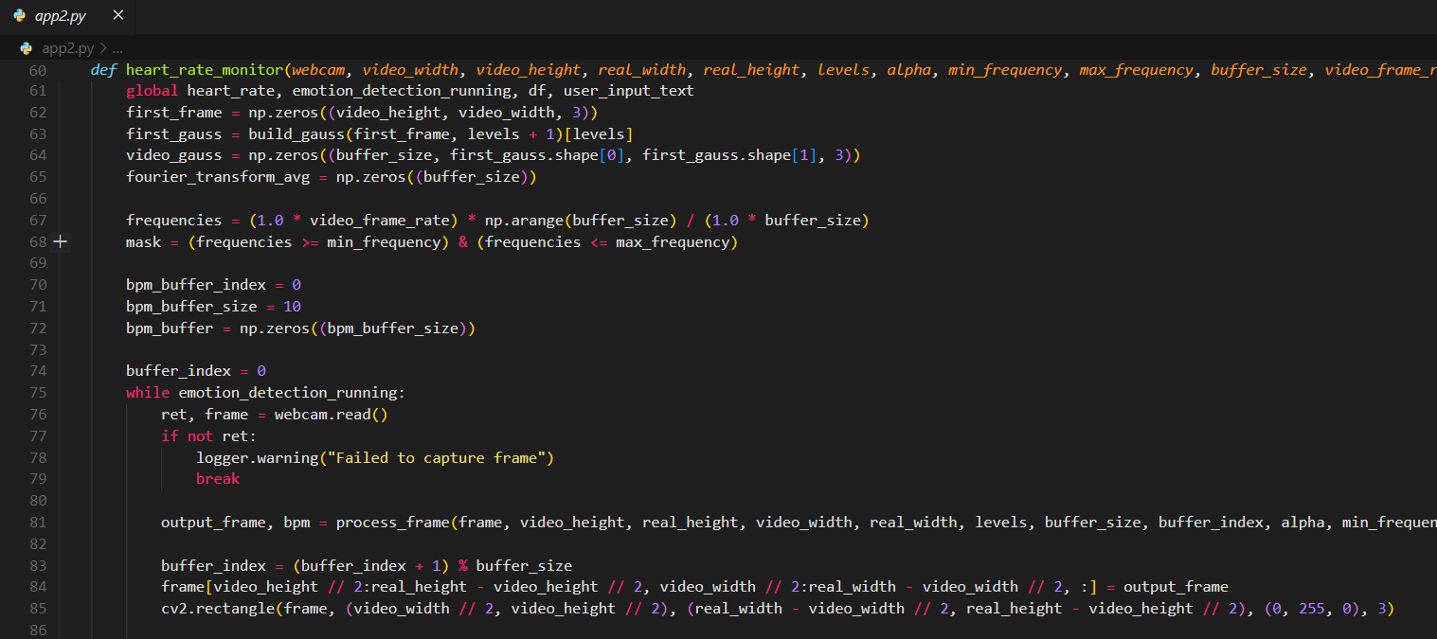
1. emotion detection utility
Heart_rate_monitor combines real-time video capture , multi scale analysis and frequency filtering to monitor the heart rate
Python based Flask backend

Slide 19
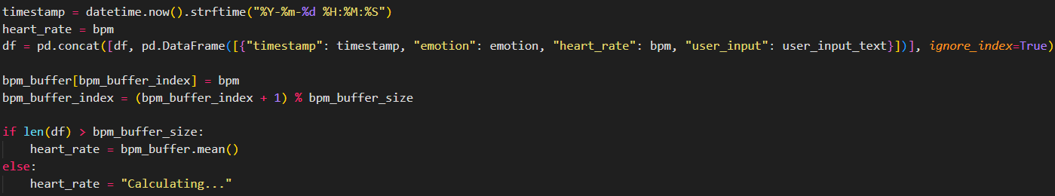
1.emotion detection utility
Python based Flask backend

Slide 20
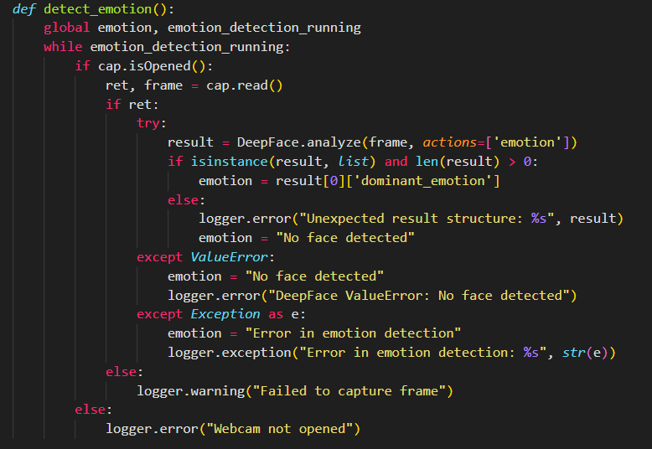
1. emotion detection utility
Python based Flask backend
Detect_emotion function runs in loop till emotion_detection_running is True . This enables continuous emotion detection.

Slide 21
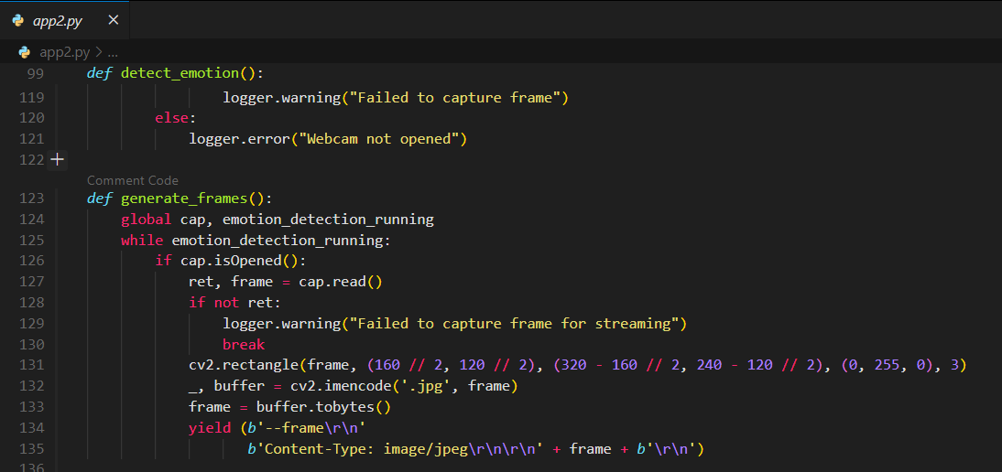
1.emotion detection utility
Detect_emotion continuously captures frames from webcam , analyses them using deepface , and updates global emotion variable.
Python based Flask backend
Generate_frames function captures frames from webcam and streams them .These frames are generated until emotion_detection_running is True .

Slide 22
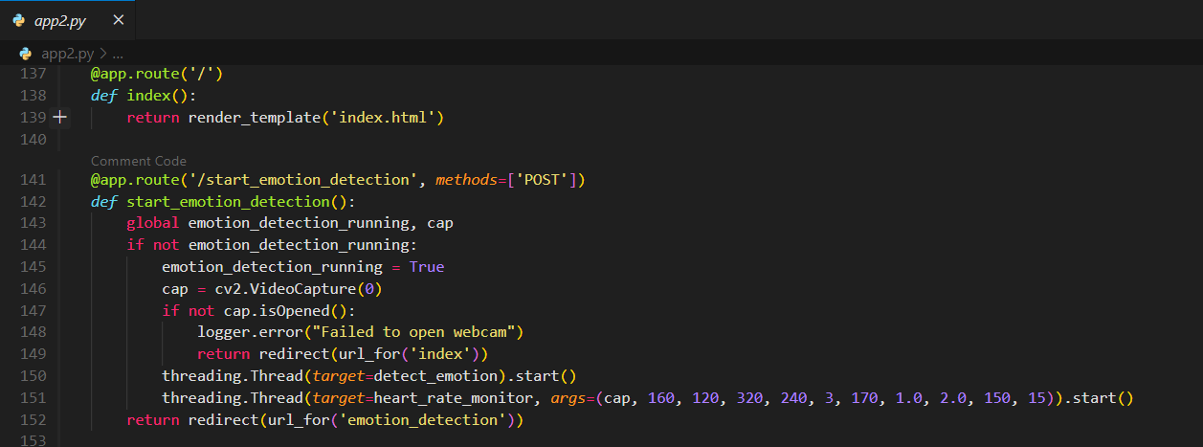
2. The Flask endpoints
/Start_emotion_detection route triggered by POST request from frontend to start emotion detection process . This route also starts heart_rate_monitor function in parallel . And finally gets redirected to /emotion_detection route

Slide 23
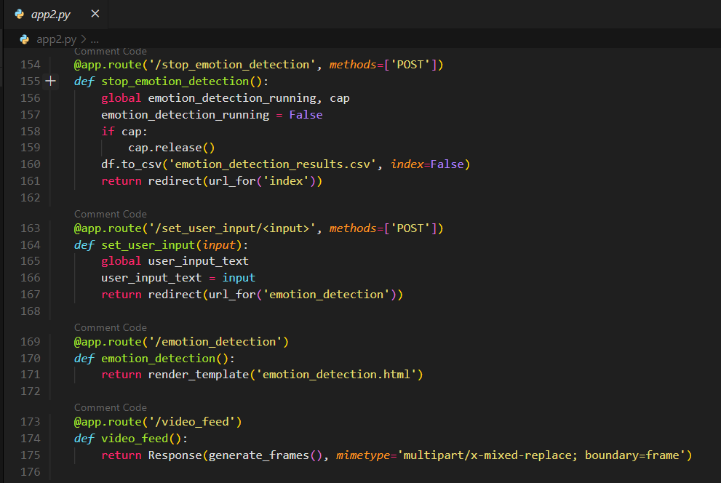
2. The Flask endpoints
/stop_emotion_detection route stops the emotion detection process by setting emotion_detection_running to False .
It releases the webcam if open and saves the recorded data to a CSV file named emotion_detection_results.csv
/set_user_input/<input> route updates global variable user_input_text by a POST request by the frontend .
/video_feed route provides live video feed using the generate_frames() function .

Slide 24
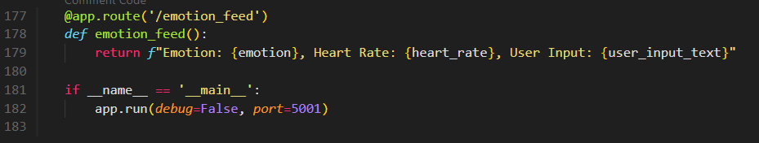
2. The Flask endpoints
NOTE: The backend server is active on https://localhost:5001

Slide 25
The database Schema - MongoDB
z

Slide 26
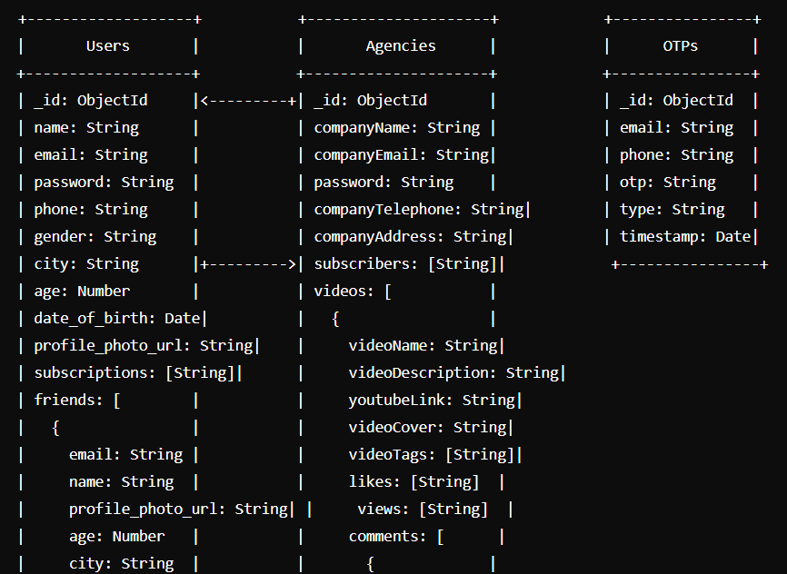
Schema diagram

Slide 27
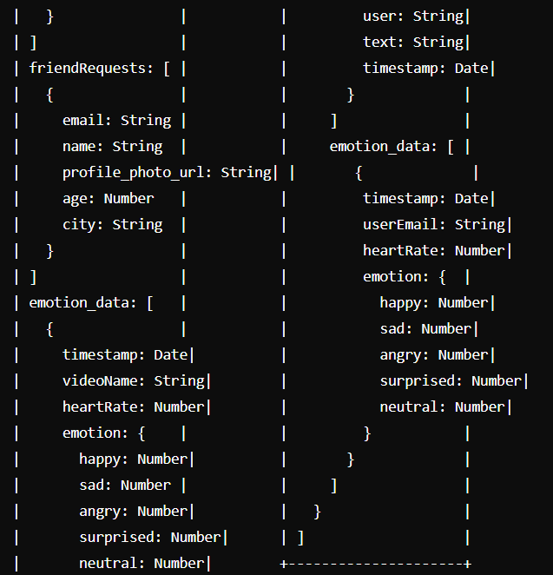
Schema diagram

Slide 28
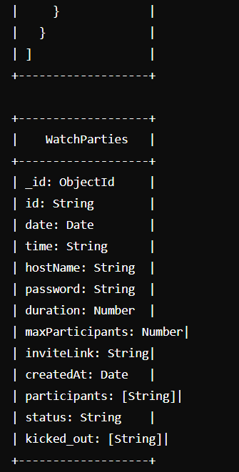
Schema diagram

Slide 29
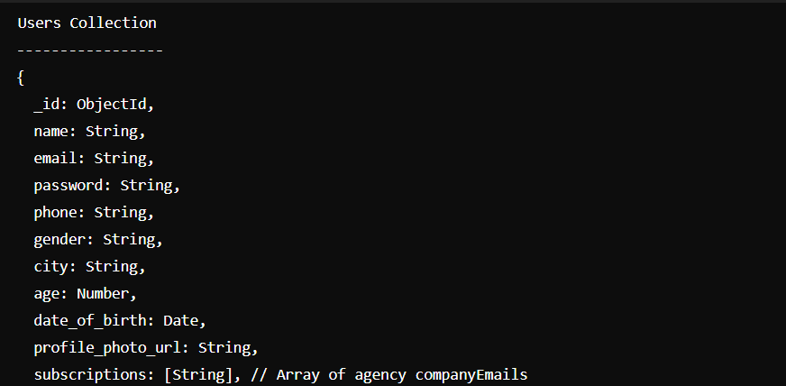
Schema Table

Slide 30
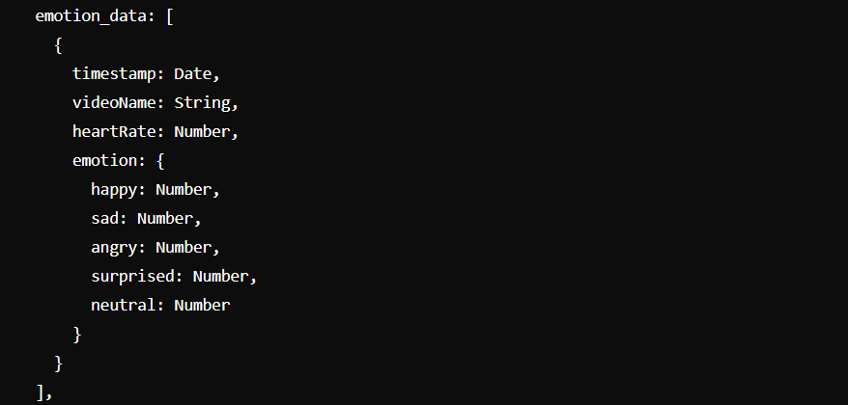
Schema Table

Slide 31
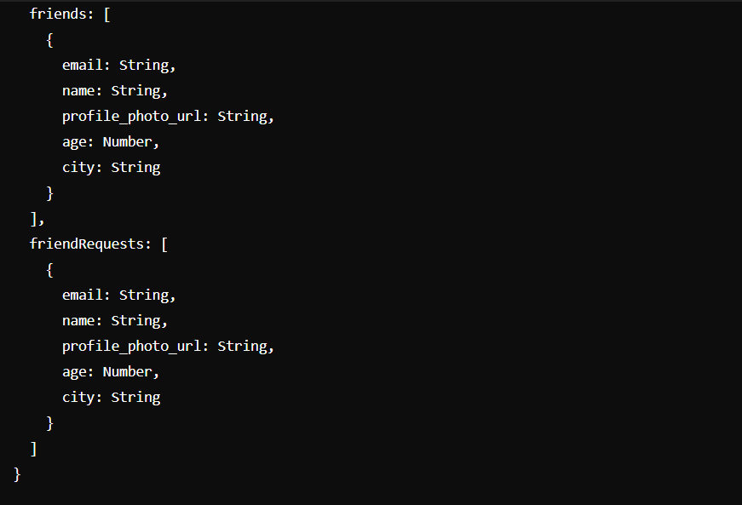
Schema Table

Slide 32
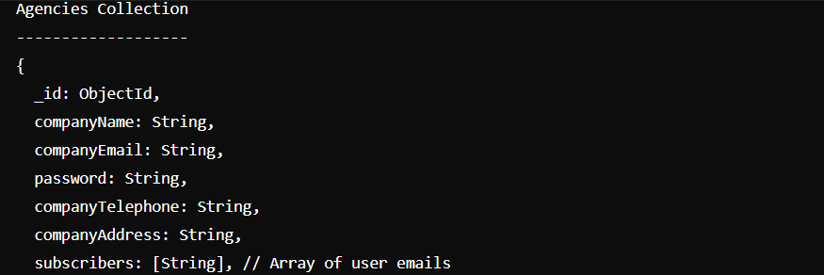
Schema Table

Slide 33
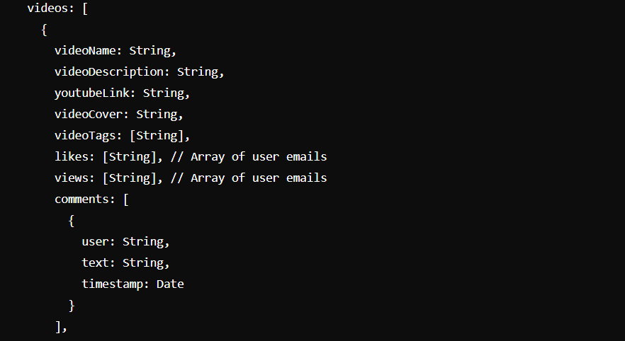
Schema Table

Slide 34
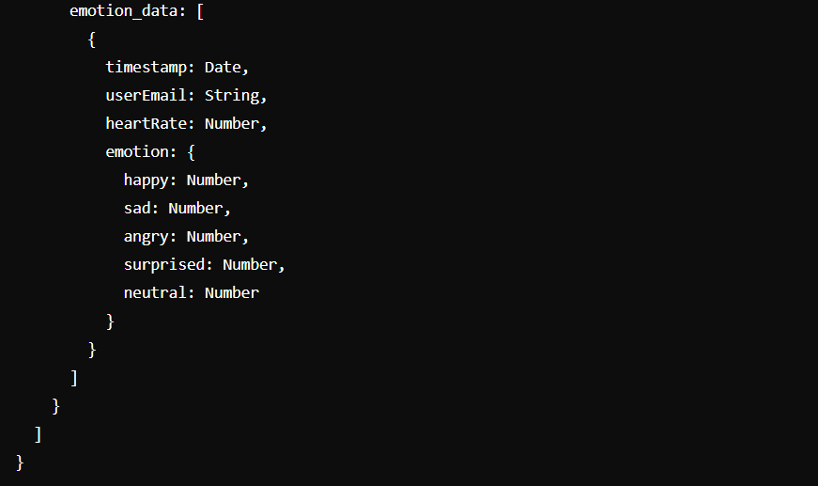
Schema Table

Slide 35
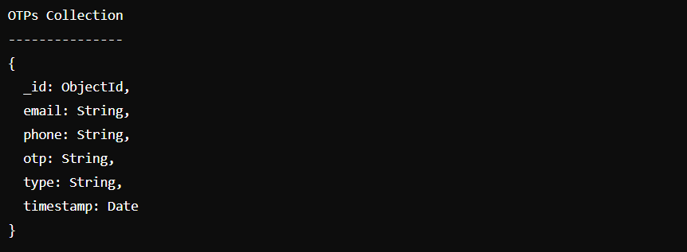
Schema Table

Slide 36
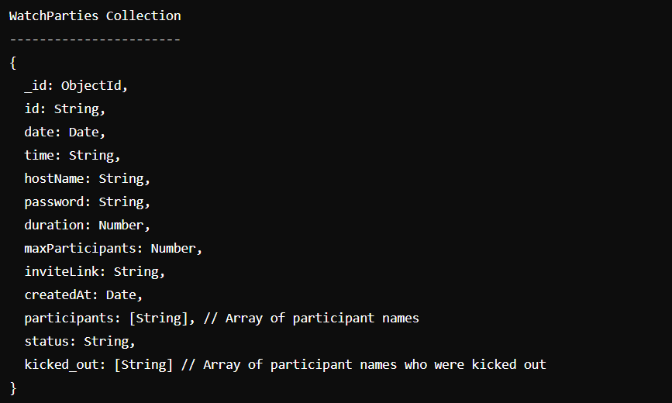
Schema Table

Slide 37
The frontend for fanNeuro
z

Slide 38
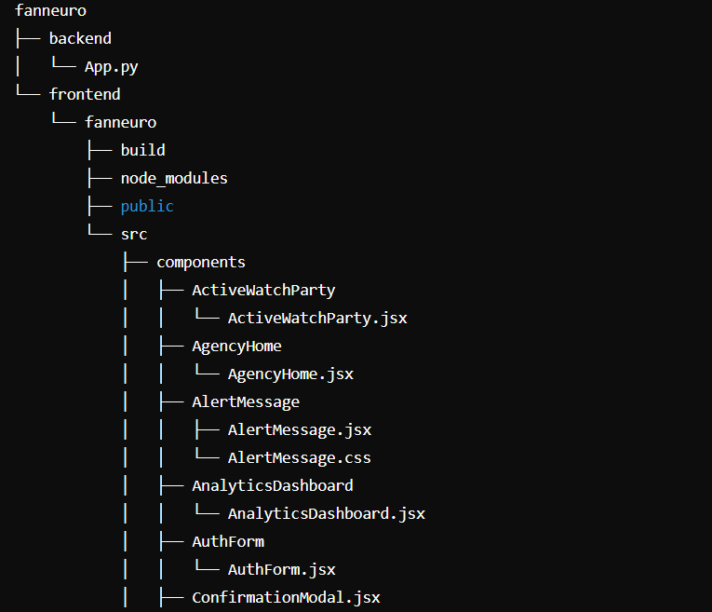
Folder Structure

Slide 39
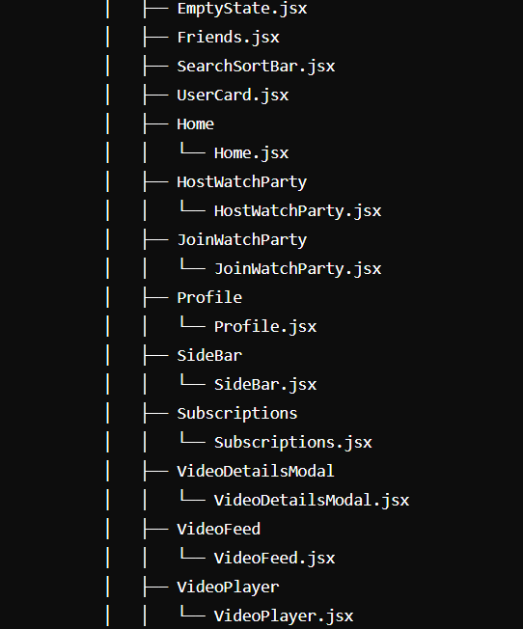
Folder Structure

Slide 40
Folder Structure

Slide 41
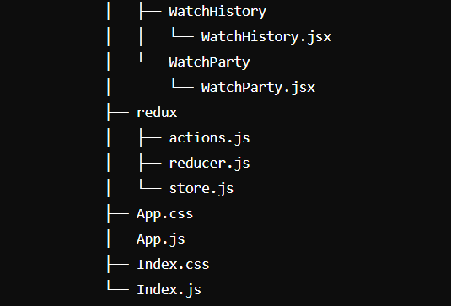
Folder Structure

Slide 42
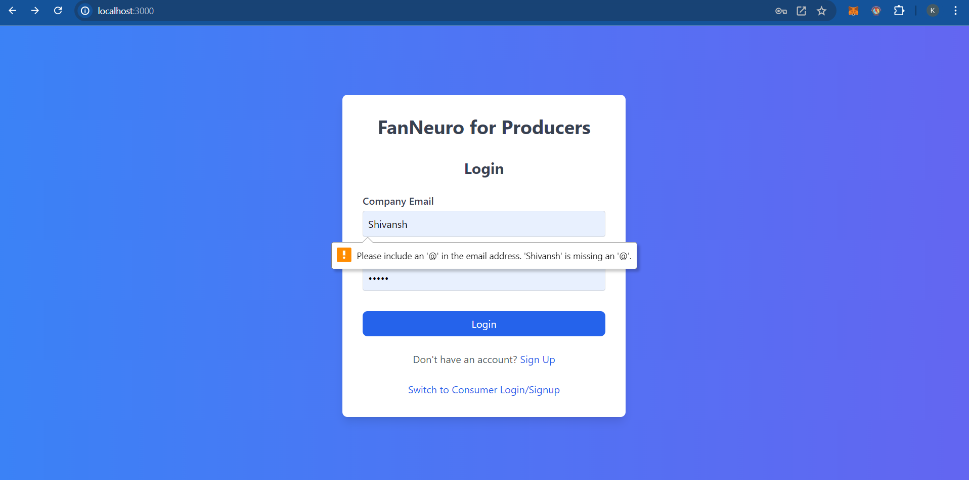
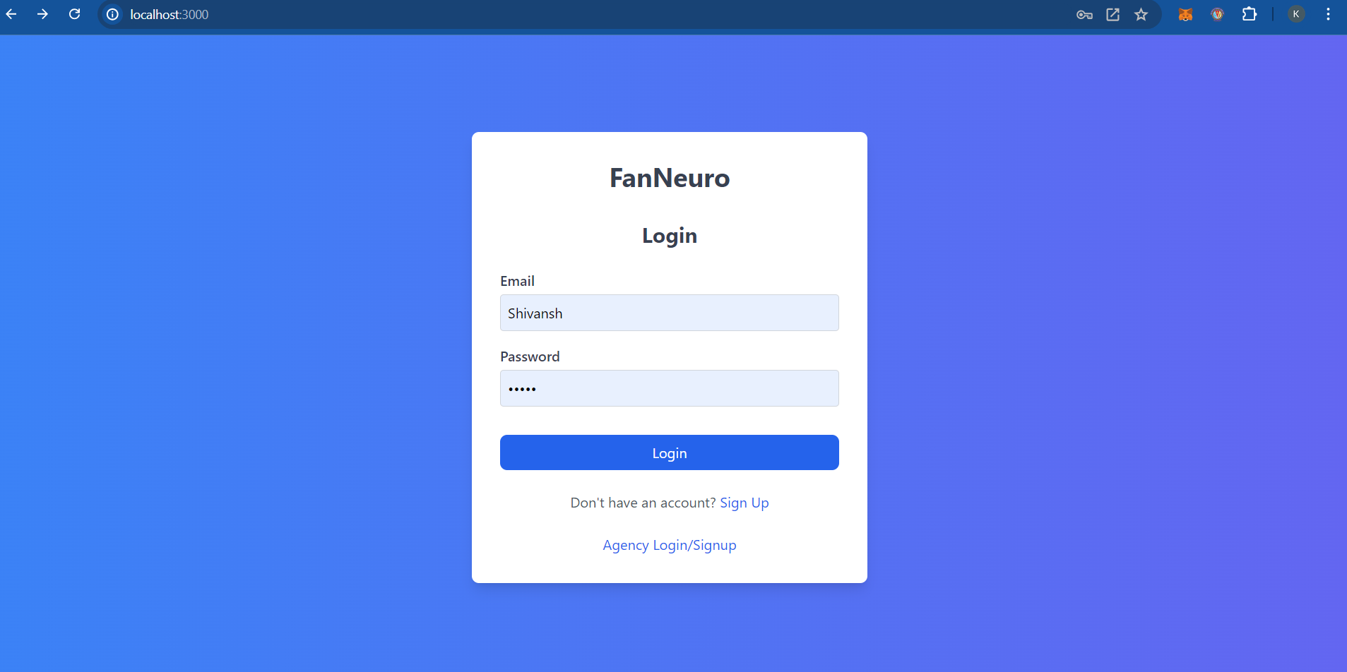
Signup/Login

Slide 43
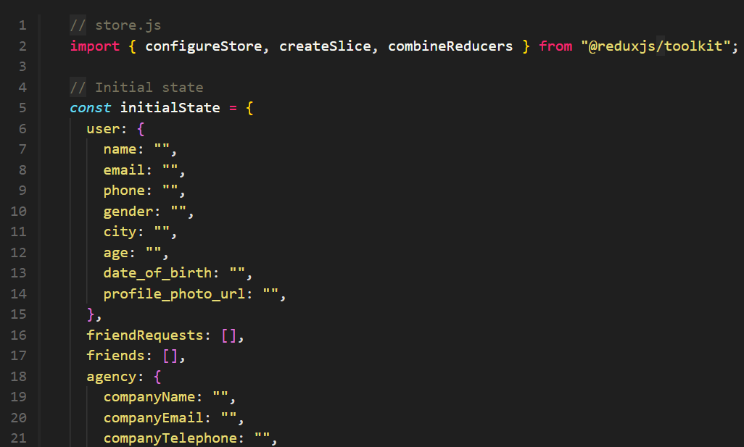
Redux store for state management

Slide 44
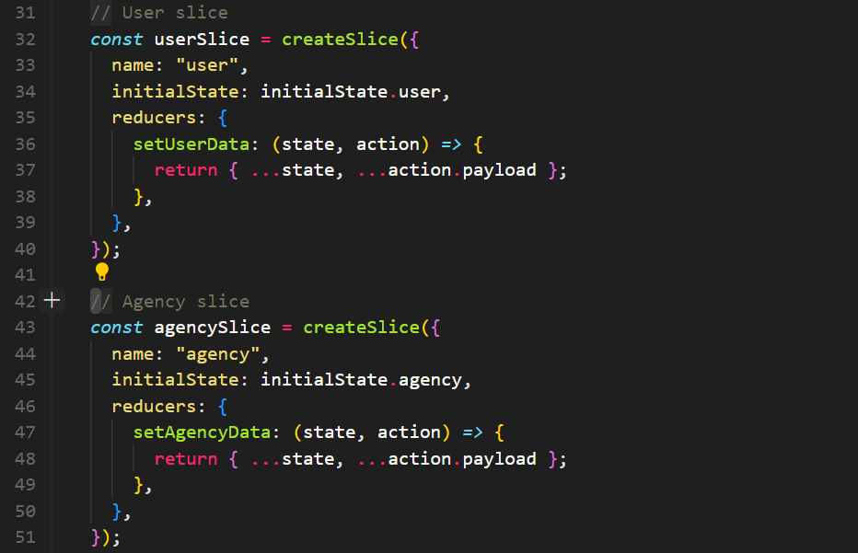
Redux store for state management

Slide 45
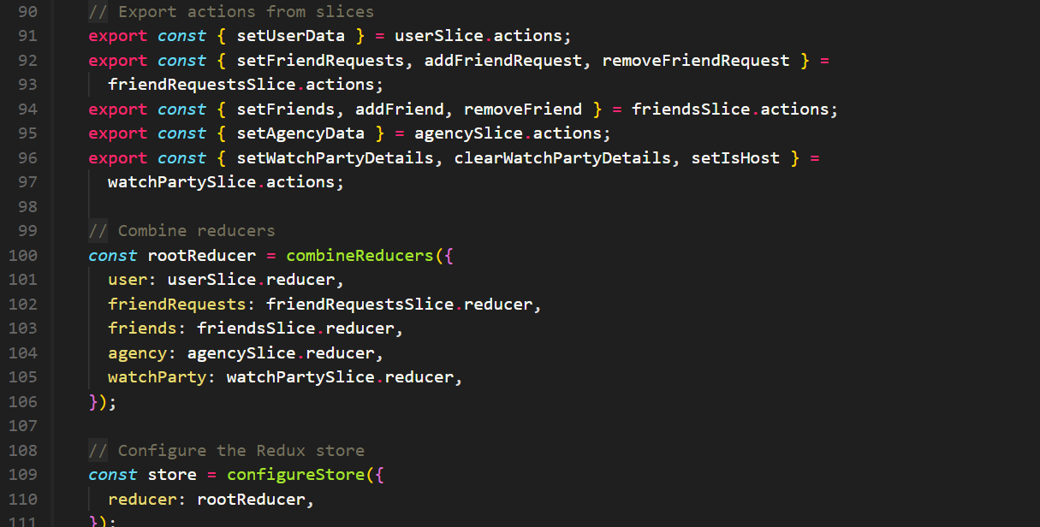
Redux store for state management

Slide 46
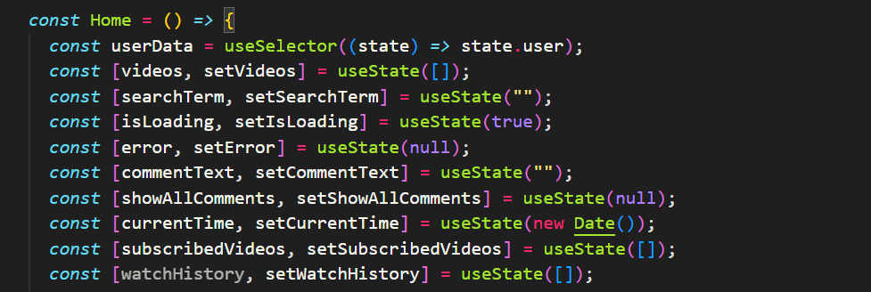
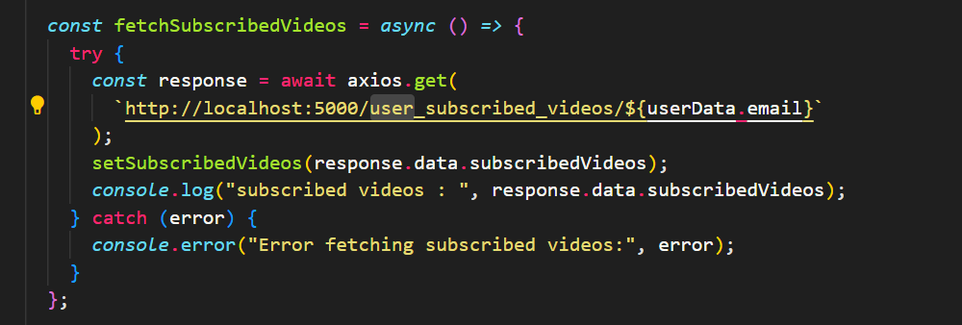
Redux store for state management -usage

Slide 47
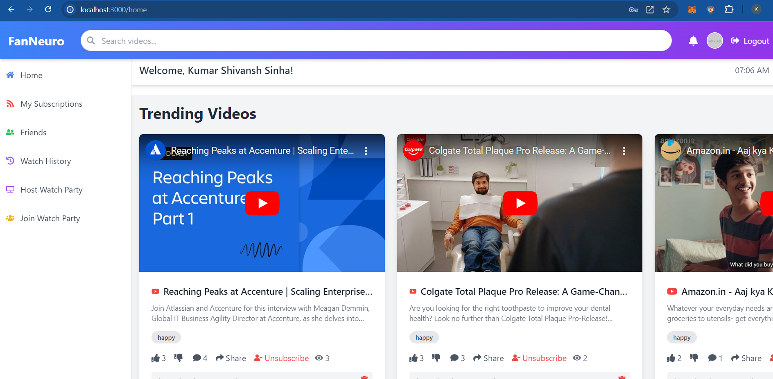
Home Page

Slide 48
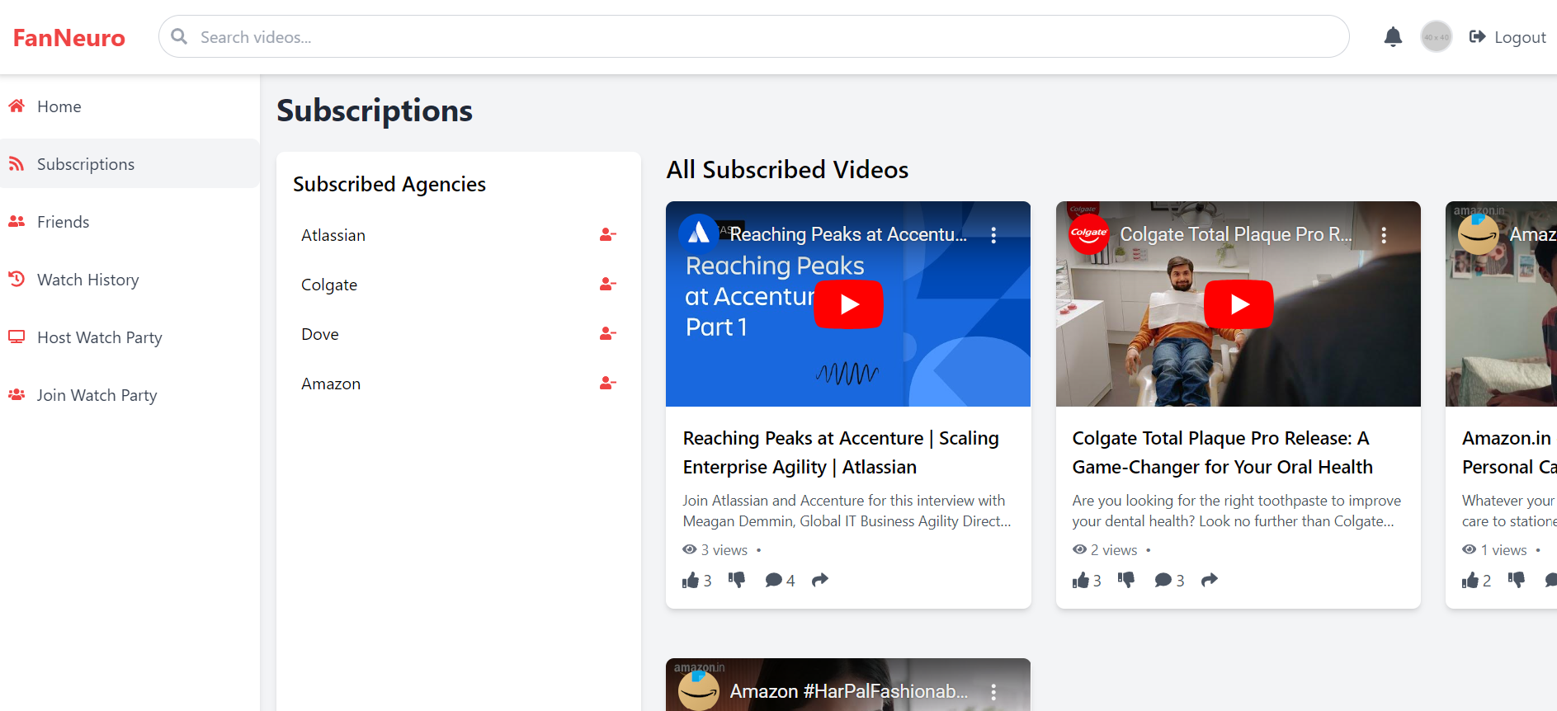
Home Page

Slide 49
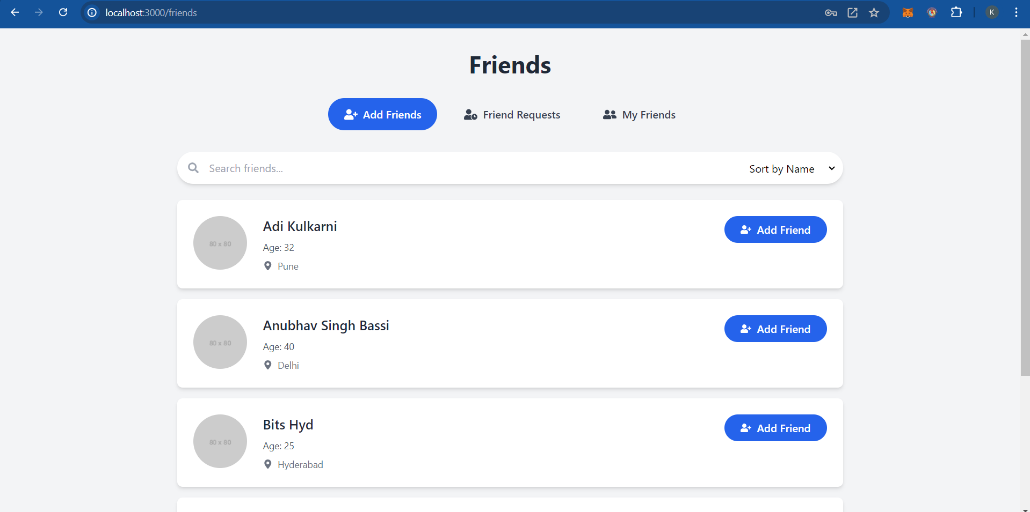
Friends Page

Slide 50
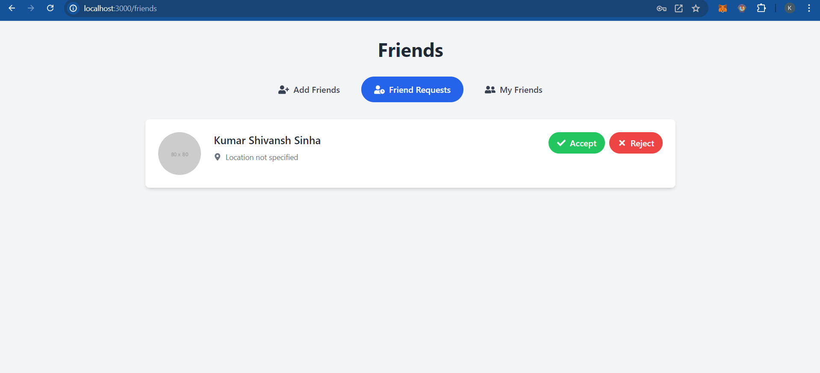
Friends Page

Slide 51
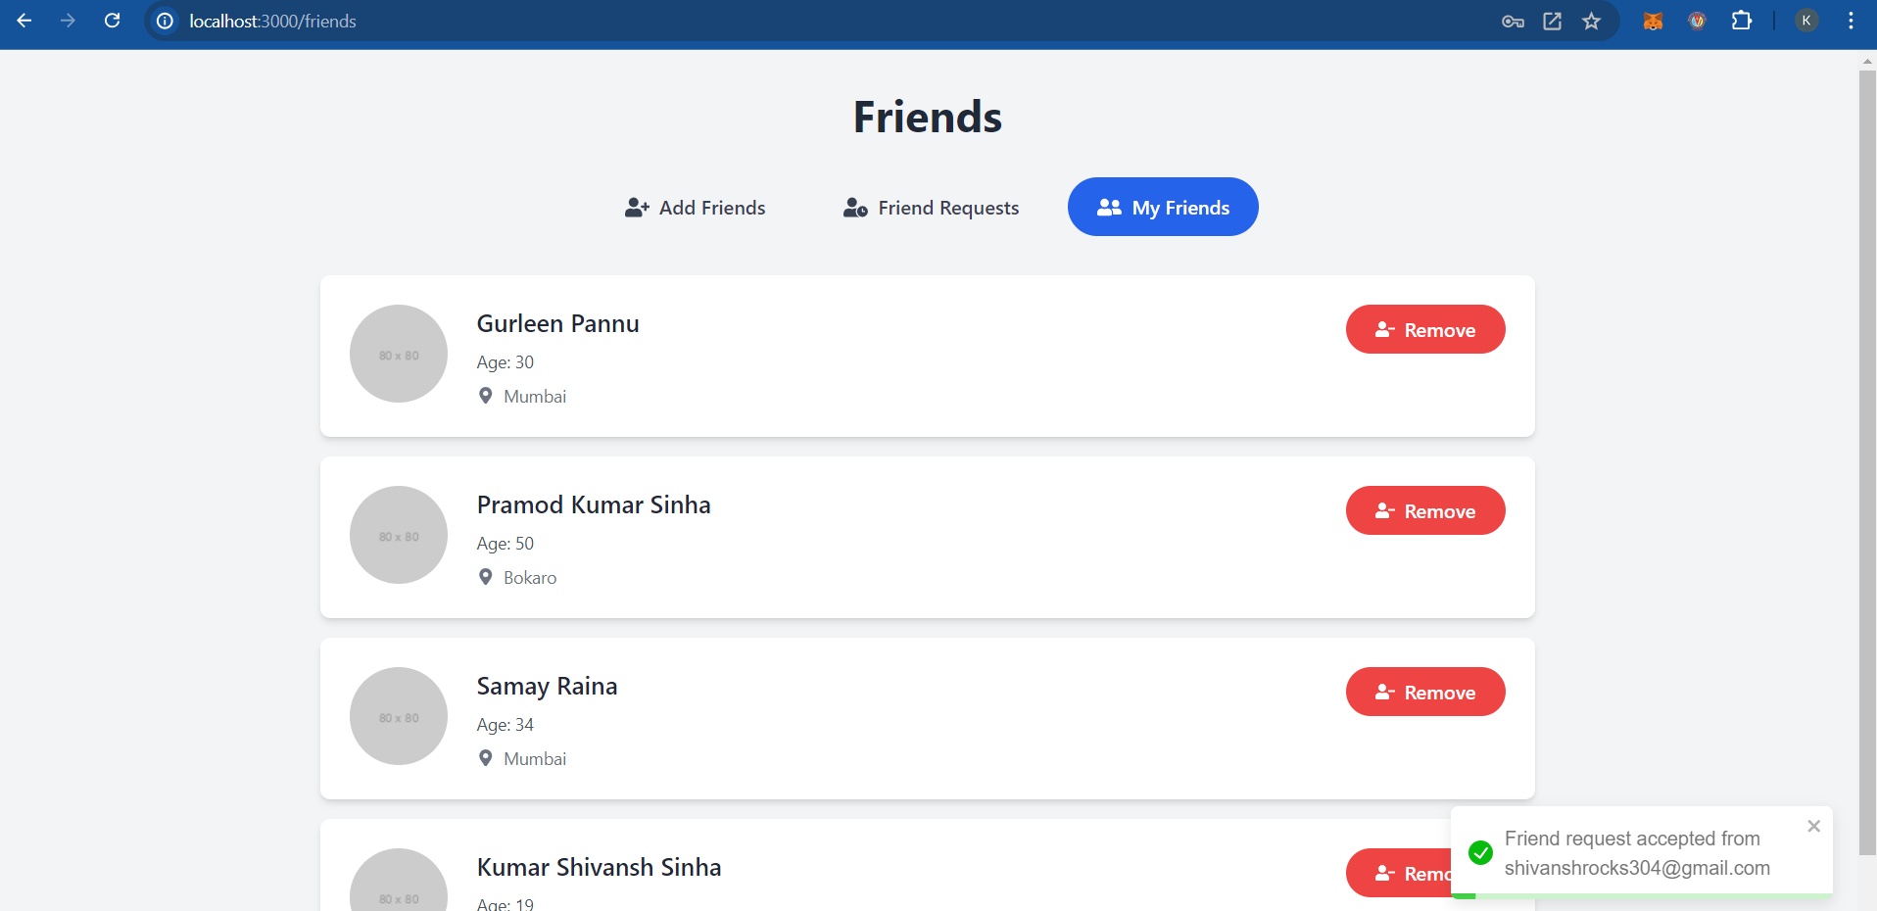
Friends Page

Slide 52
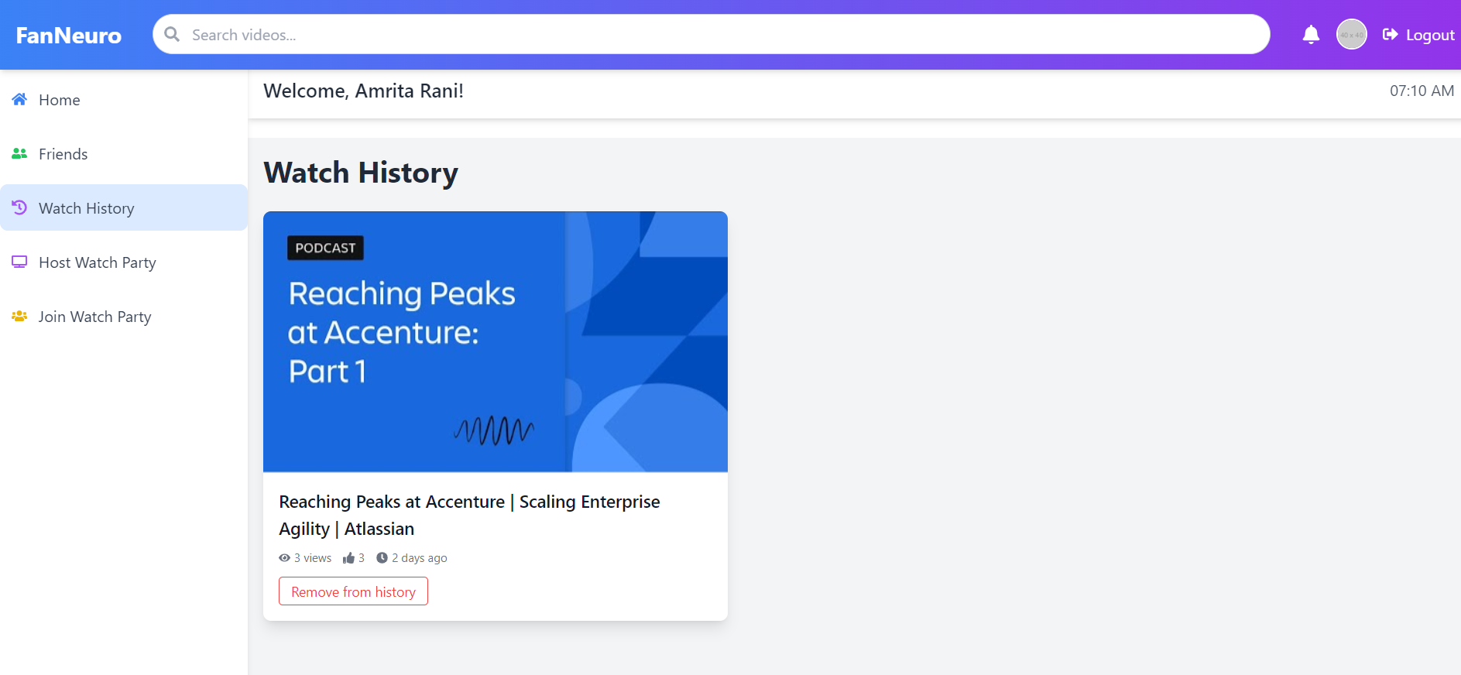
Watch History

Slide 53
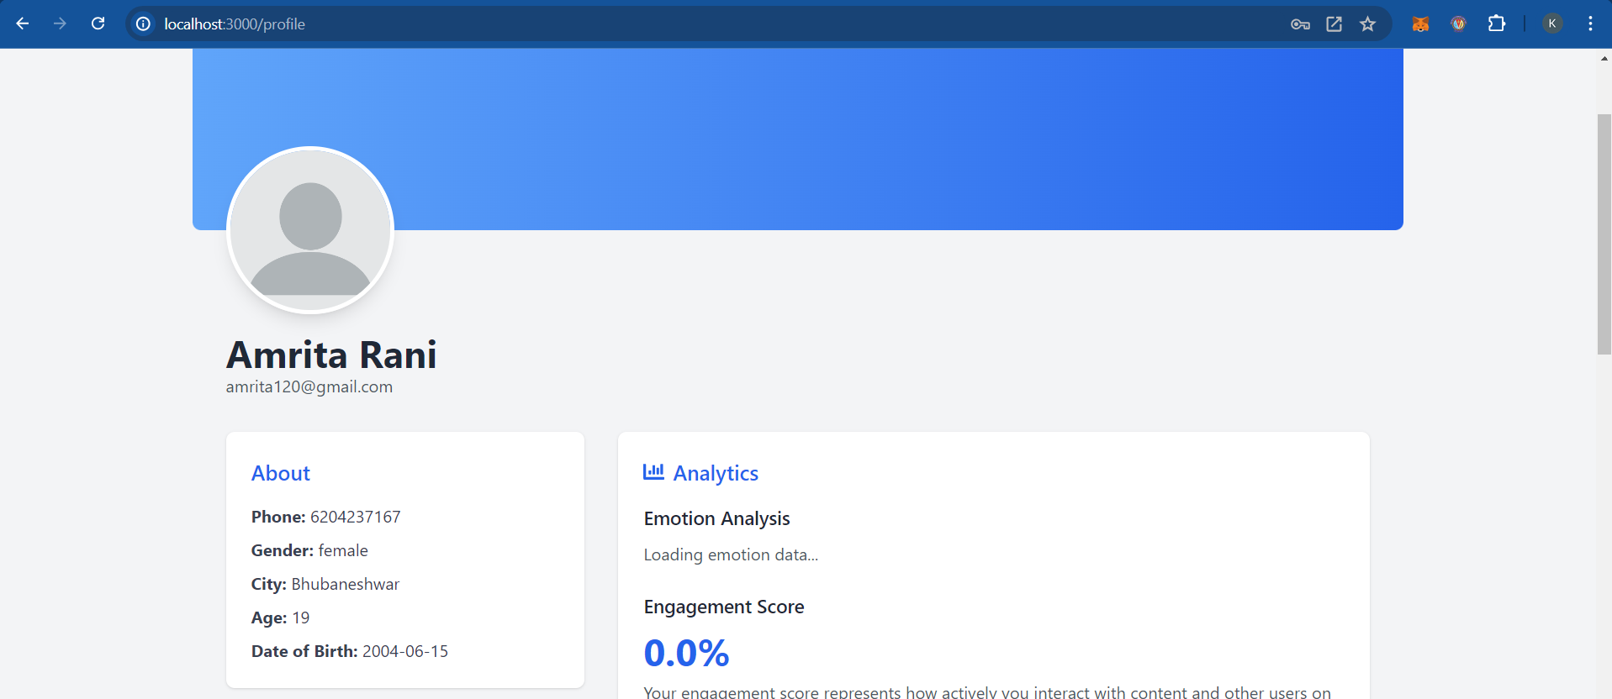
Profile

Slide 54
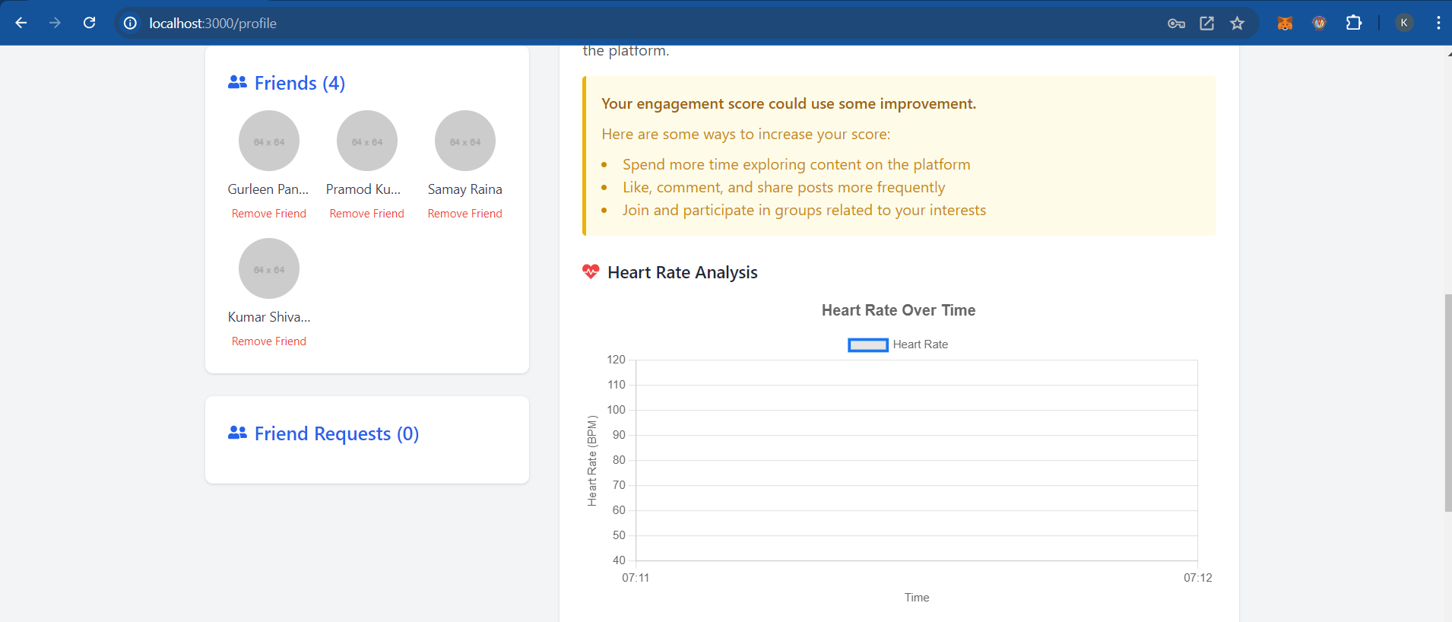
Profile

Slide 55
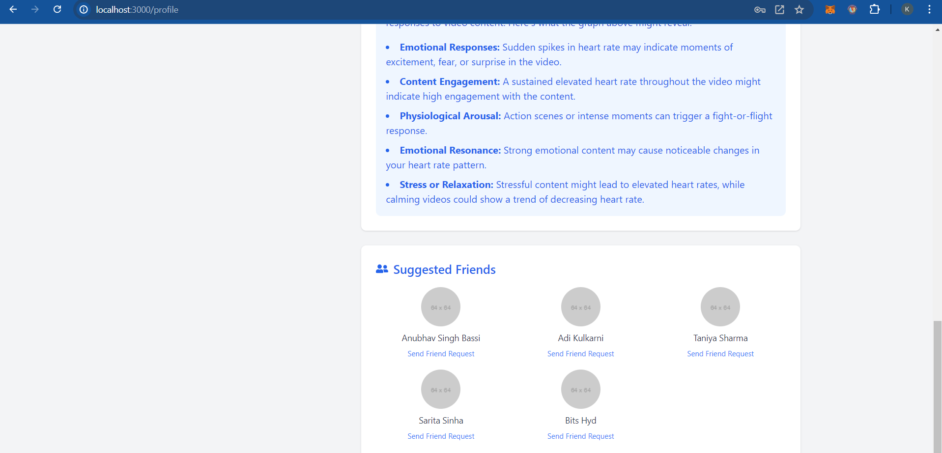
Profile

Slide 56
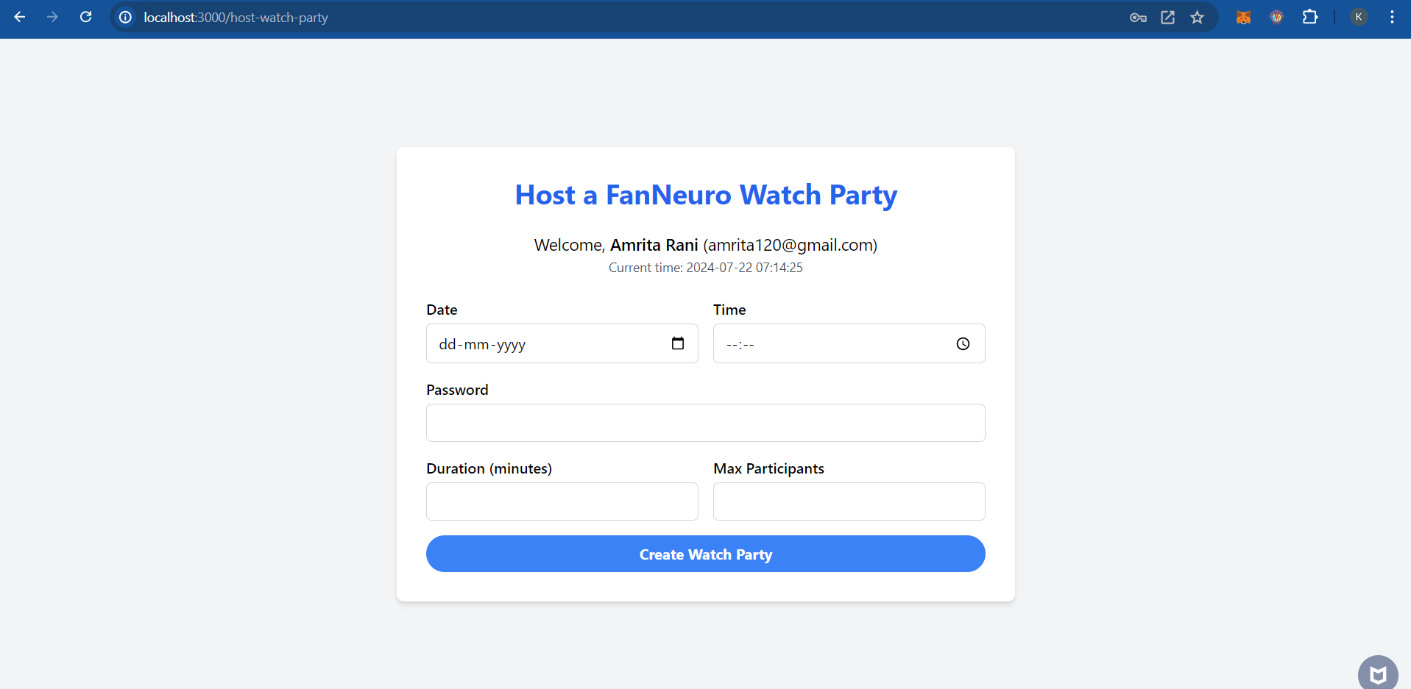
Watch Party

Slide 57
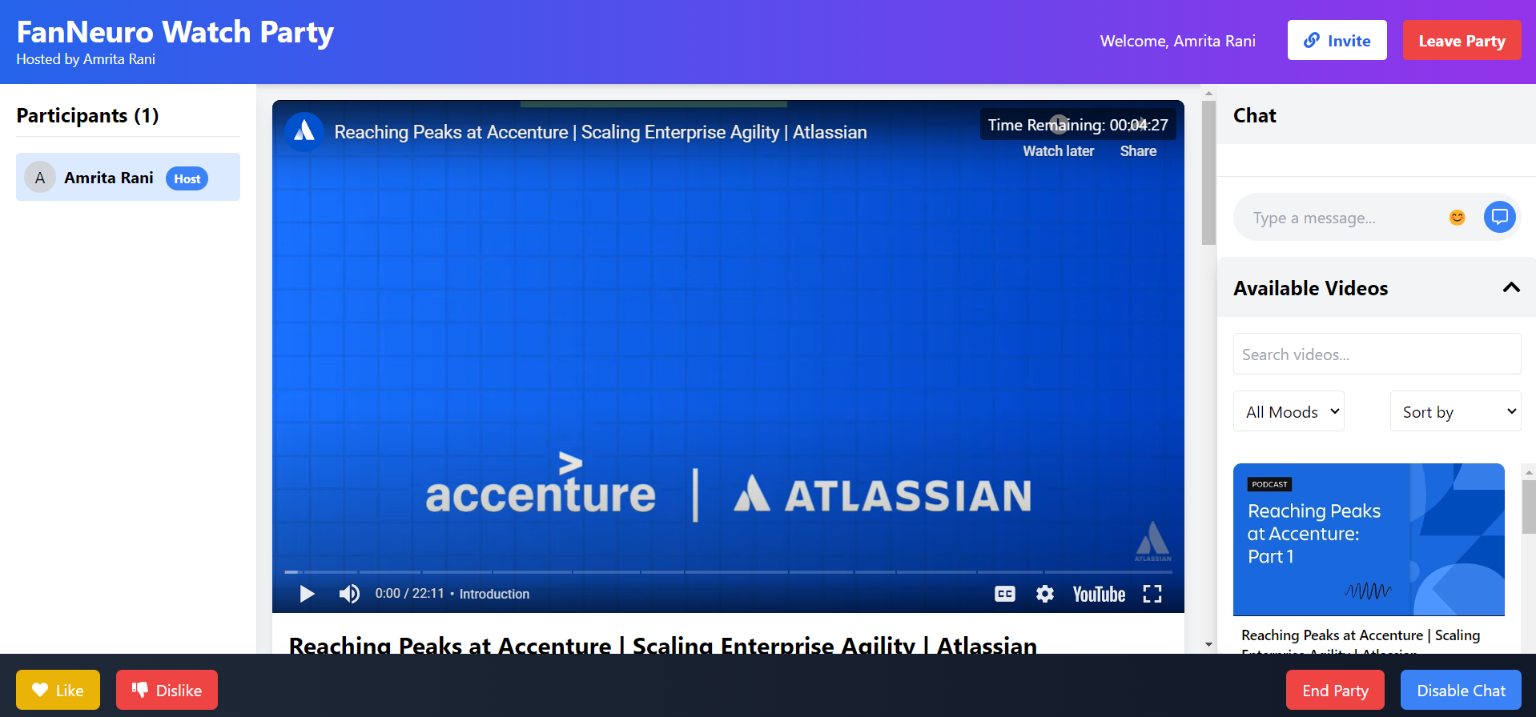
Watch Party

Slide 58
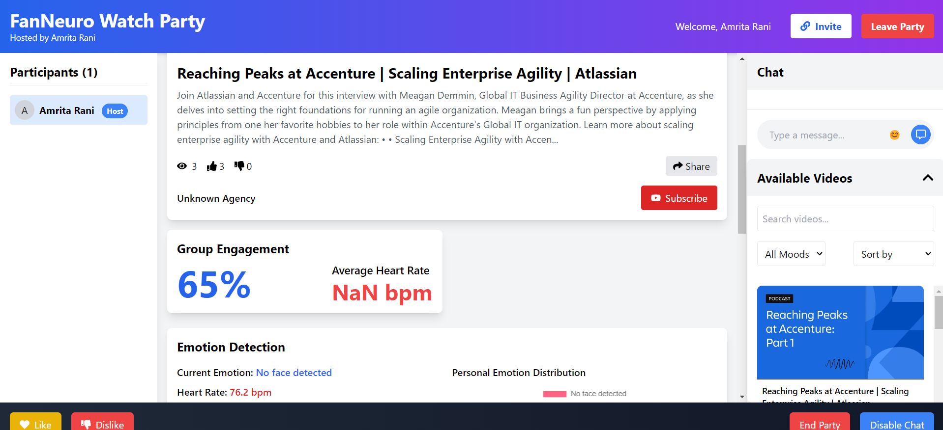
Watch Party

Slide 59
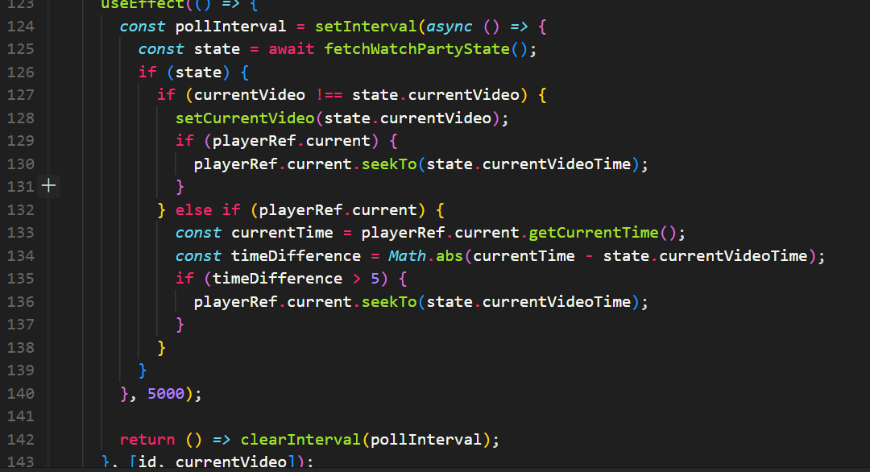
Watch Party – polling mechanism for video synchronization

Slide 60
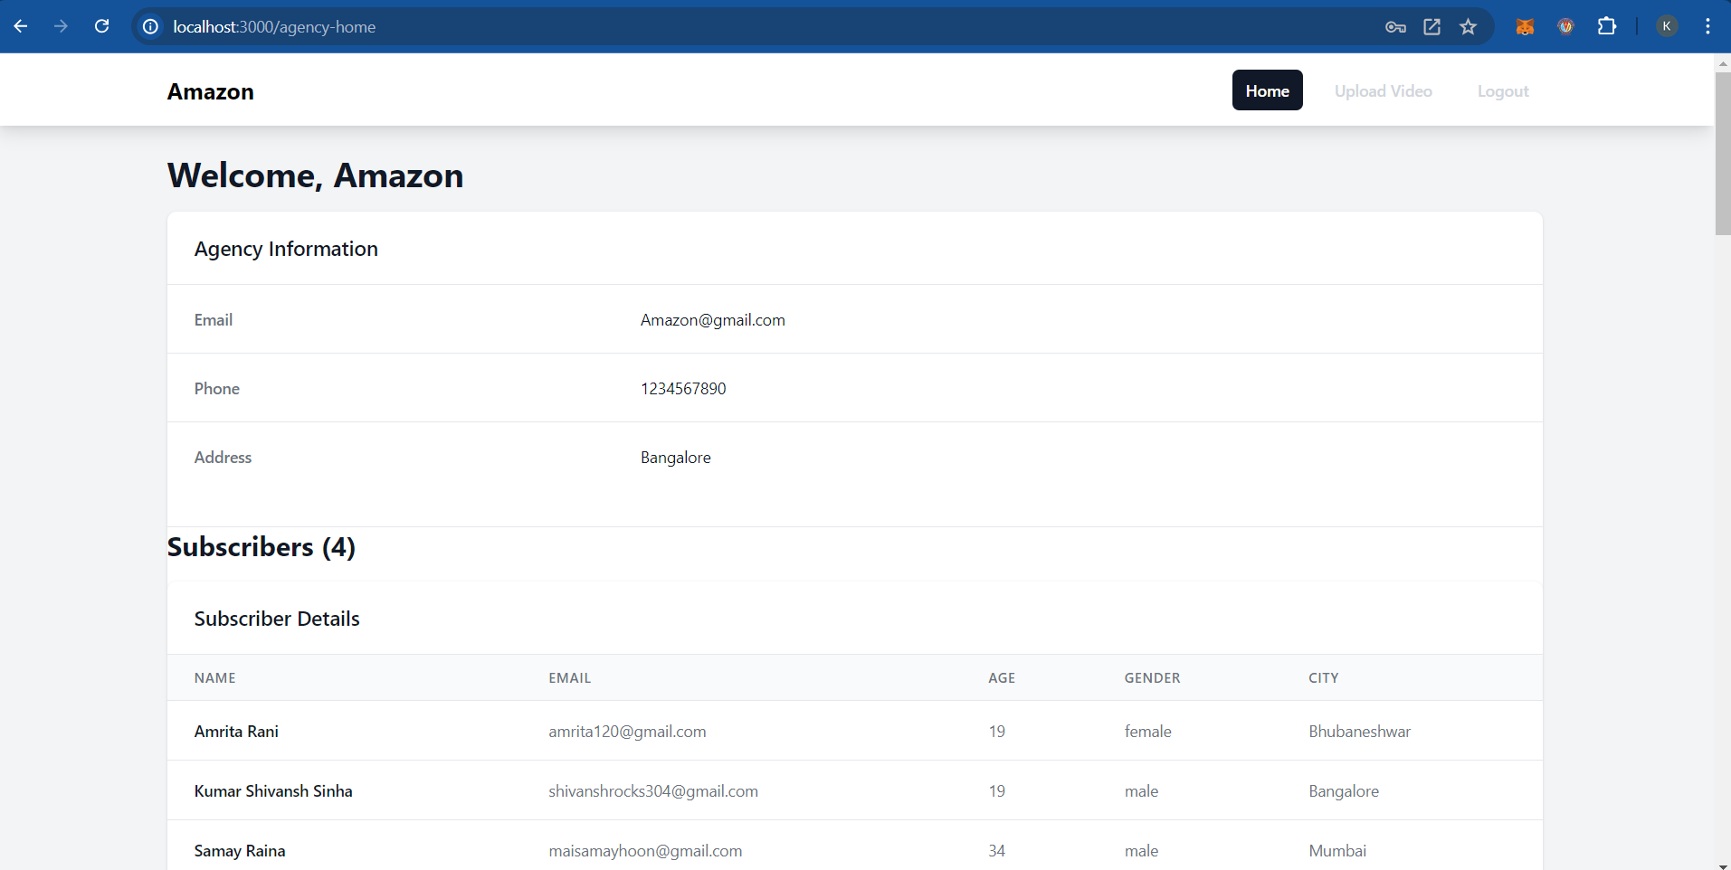
The Agency

Slide 61
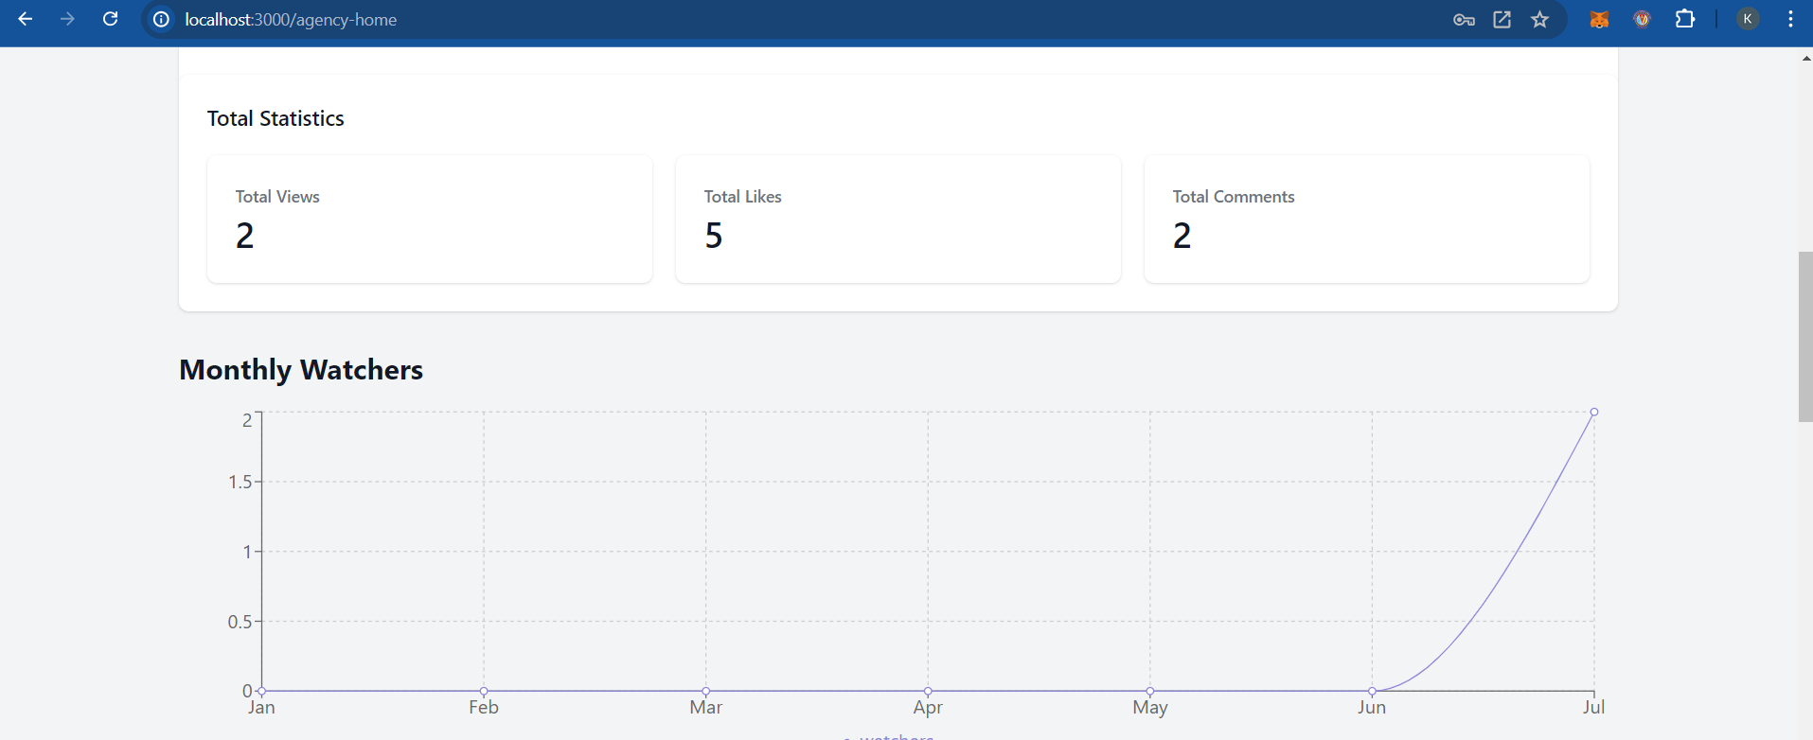
The Agency

Slide 62
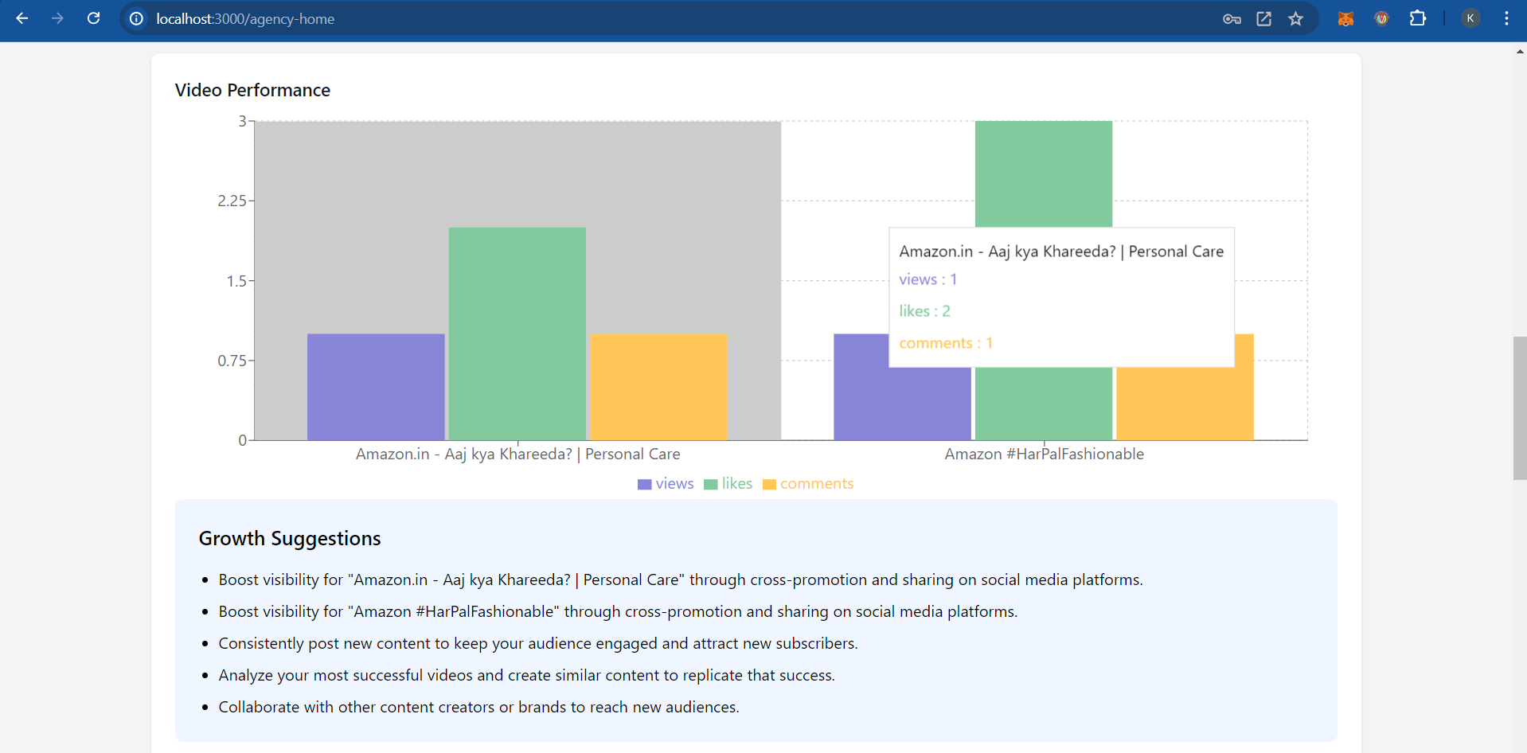
The Agency

Slide 63
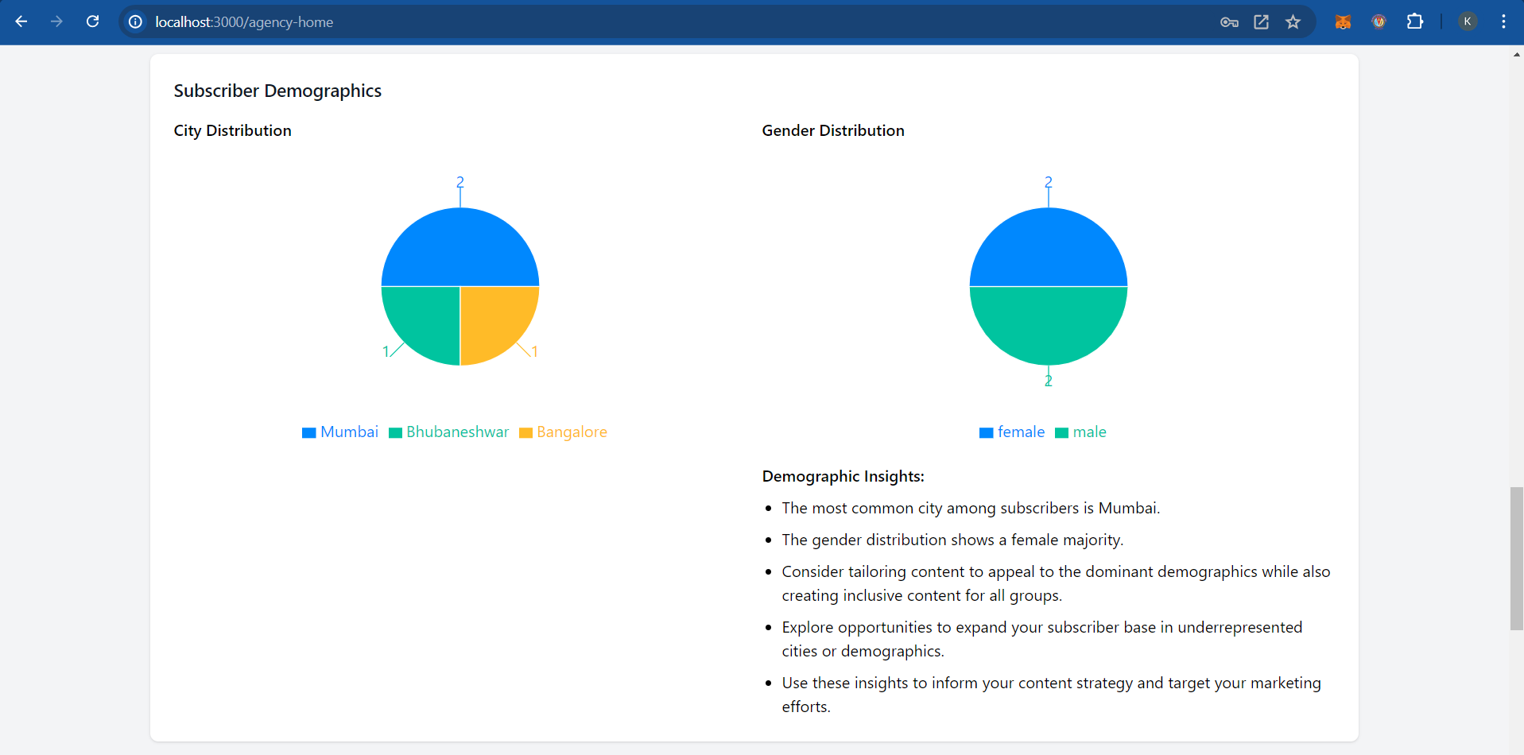
The Agency

Slide 64
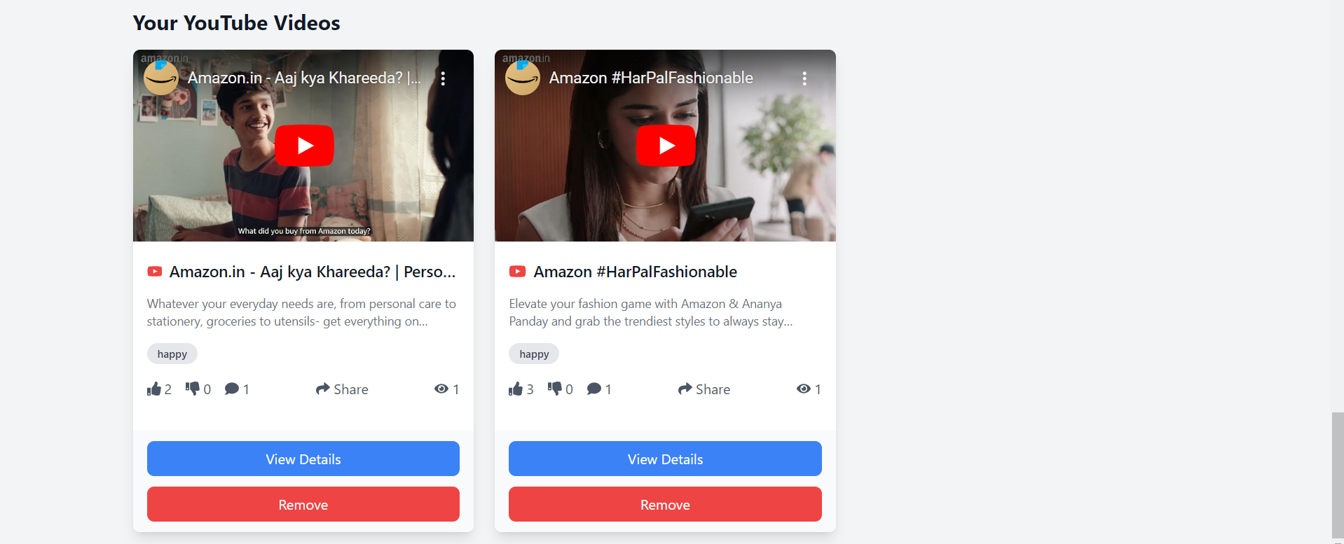
The Agency

Slide 65
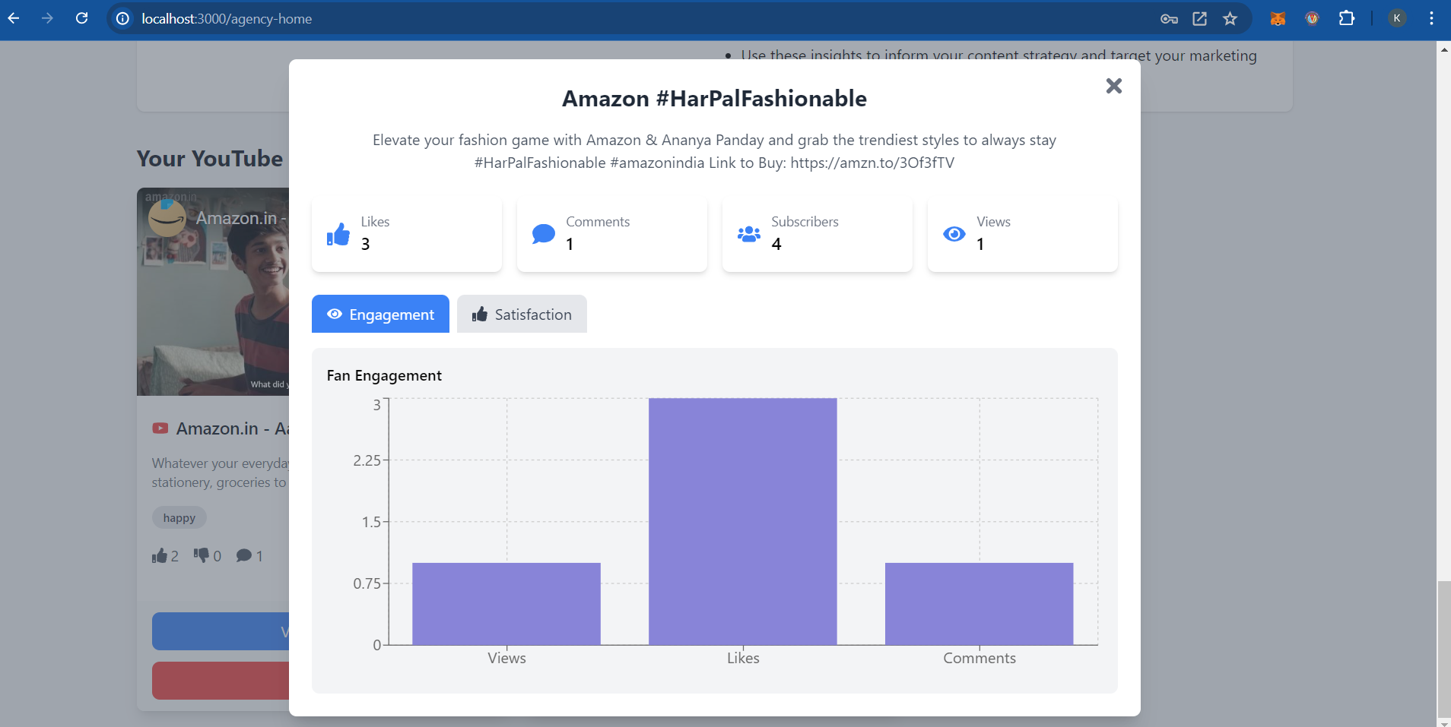
The Agency
Notes:
WebSockets
WebSockets provide a full-duplex communication channel over a single, long-lived connection. This allows for real-time data exchange between the client and the server without the need for repeated HTTP requests. WebSockets are well-suited for applications that require low-latency updates, such as live chats, gaming, and real-time notifications.
Advantages of WebSockets:
Low Latency: WebSockets enable real-time communication, reducing the delay between the client and server.
Efficient Use of Resources: Once the connection is established, data can flow freely between the client and server without the overhead of establishing new connections.
Bidirectional Communication: WebSockets allow data to be sent and received simultaneously, making it ideal for interactive applications.
Polling Mechanism
Polling is a technique where the client periodically sends requests to the server to check for new data. Unlike WebSockets, which maintain a constant connection, polling uses repeated HTTP requests at regular intervals.
Advantages of Polling:
Simplicity: Polling is straightforward to implement and does not require maintaining a persistent connection, making it suitable for simple use cases.
Compatibility: Polling works with standard HTTP protocols and does not require special server configurations, making it compatible with a wide range of environments and technologies.
Resource Management: In environments with strict resource constraints, polling can be more manageable, as it avoids the overhead of maintaining long-lived connections.

Slide 66

The Agency

Slide 67

A measure of satisfaction score

Slide 68
Let’s see em’ live
z

Slide 69
Further Scopes
Shifting from Polling mechanism to WebSockets
Integration with AWS services
Server Load Balancing and Efficiency
Refinement of the Model , More efficient analytics
CI/CD Pipelines and final deployment
Planning more security

